Slide 1
Computer Programming Basics
Jeon, Seokhee
Assistant Professor
Department of Computer Engineering,
Kyung Hee University, Korea

Slide 2
CHAPTER 4
FUNCTIONS - 1

Slide 3
Designing Structured Programs
In top-down design, a program is divided into a main module and its related modules. Each module is in turn divided into submodules until the resulting modules are intrinsic; that is, until they are implicitly understood without further division.

Slide 4
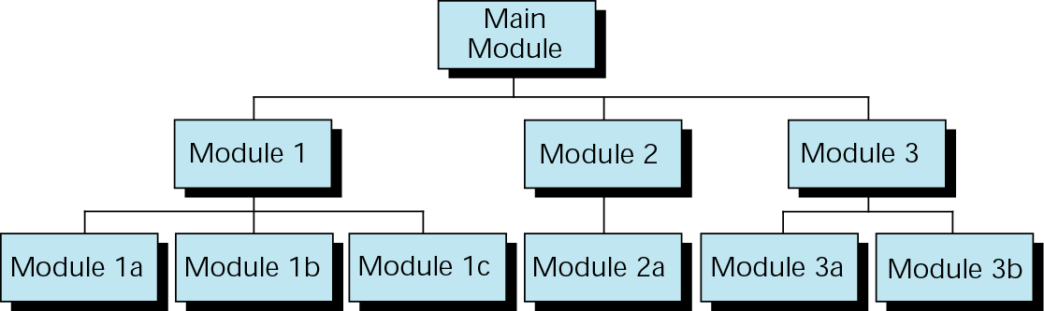
Structure Chart

Slide 5
Functions in C++
In C++, a program is made of one or more functions, one and only one of which must be named main. The execution of the program always starts with main, but it can call other functions to do some part of the job.

Slide 6
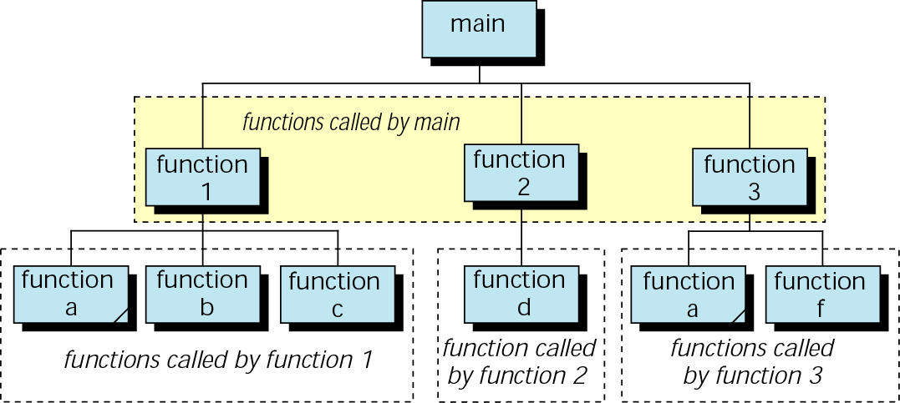
Structure Chart for a C++ Program

Slide 7
Functions in C++
A function in C++ can have a value, a side effect, or both.
  The side effect occurs before the value is returned.
  The function’s value is the value of the expression in the return statement.
  A function can be called for its value, its side effect, or both.

Slide 8
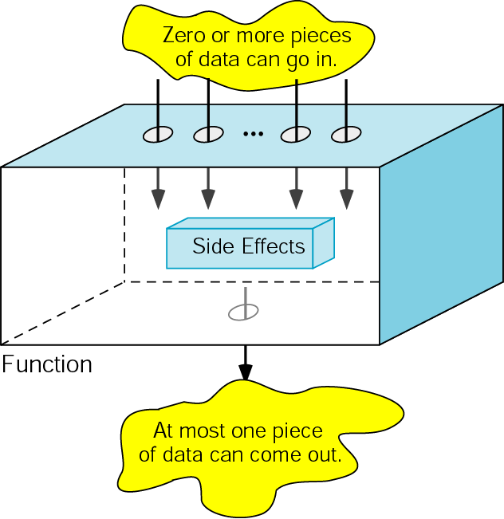
Functions in C++

Slide 9
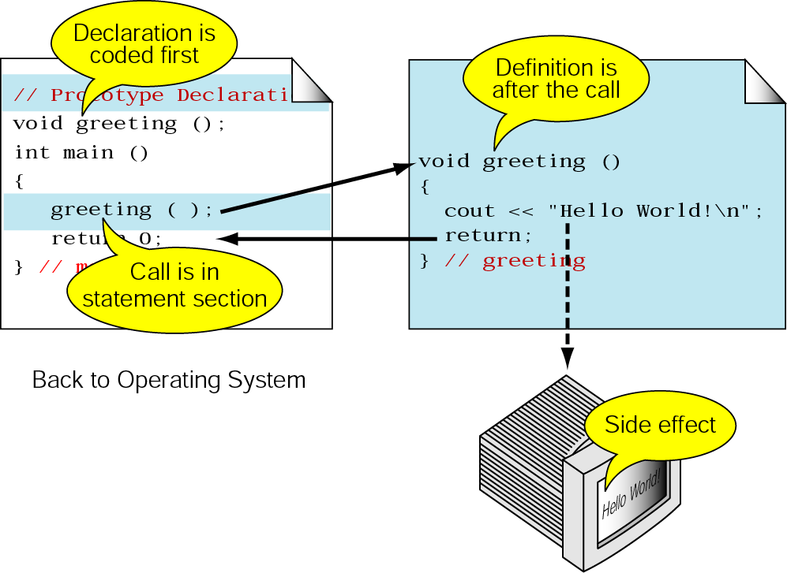
User-Defined Functions
- Declaring, Calling, and Defining

Slide 10
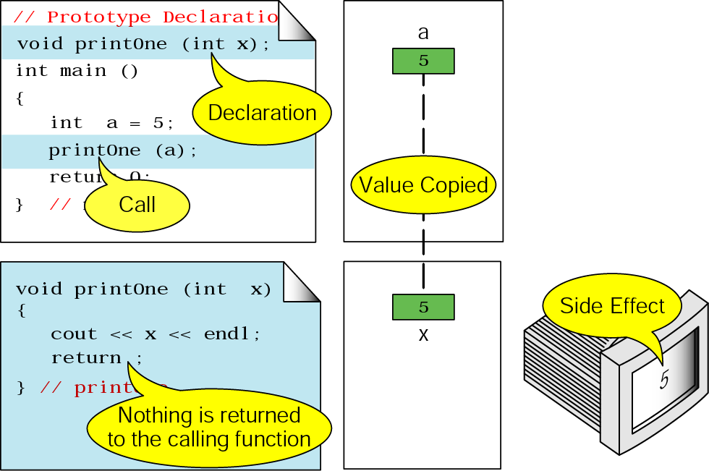
Functions without Return Value
(Only Have Side Effect)

Slide 11
Functions without Return Value
(Only Have Side Effect)
void functions cannot be used in an expression; they must be a separate statement.
Functions that return a value may be used in an expression or as a separate statement.

Slide 12
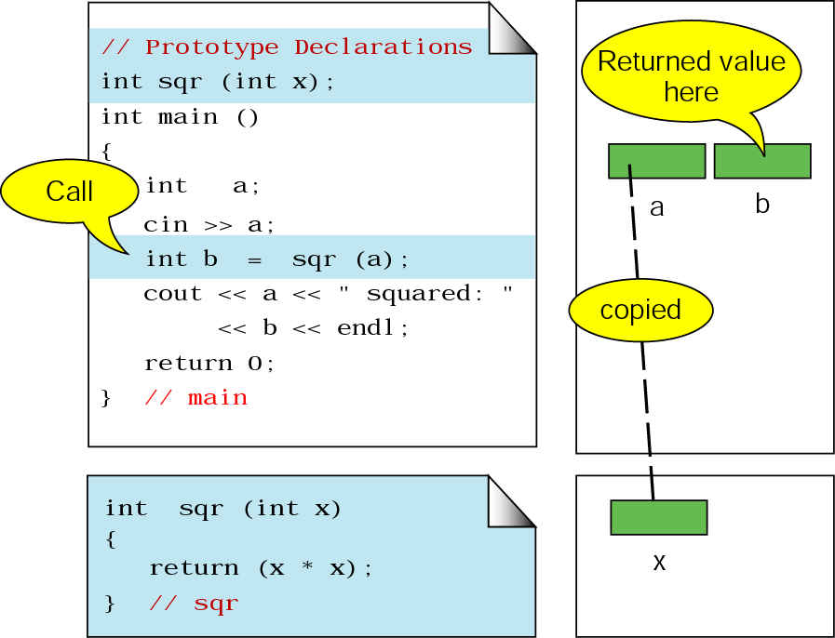
Functions with Return Value

Slide 13
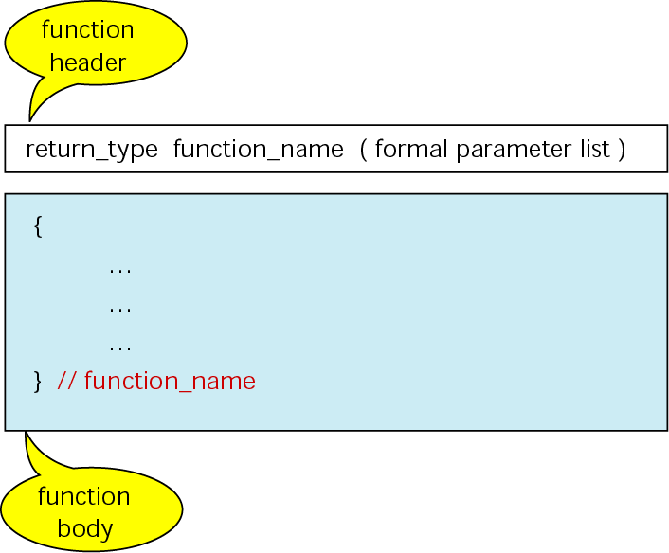
Function Definition

Slide 14
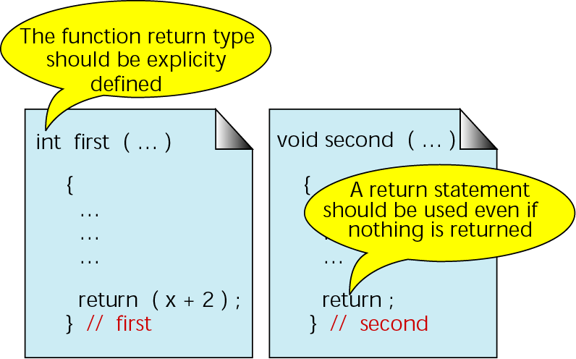
Function Return Statements

Slide 15
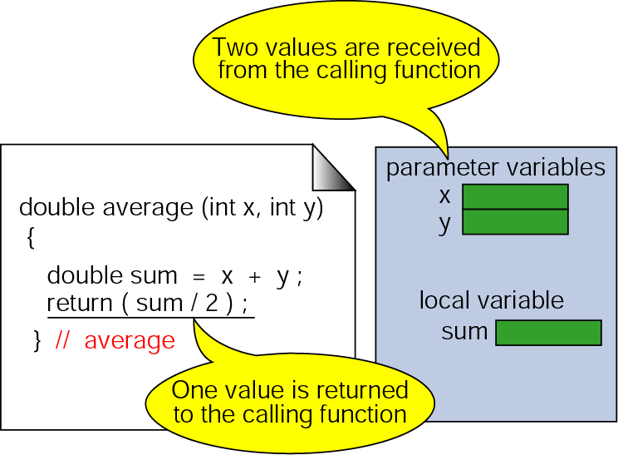
Function Local Variables

Slide 16
Notes on Parameters
Formal parameters are variables that are declared in the header of the function definition.
Actual parameters are the expressions in the calling statement.
The formal and actual parameters must match exactly in type, order, and number. Their names, however, do not need to be the same.

Slide 17
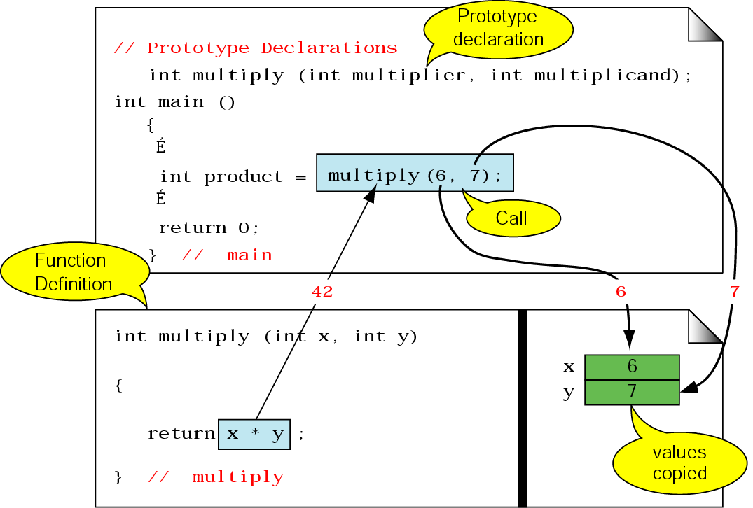
Part of a Function Call
The type of the expression in the return statement must match the return type in the function header.

Slide 18
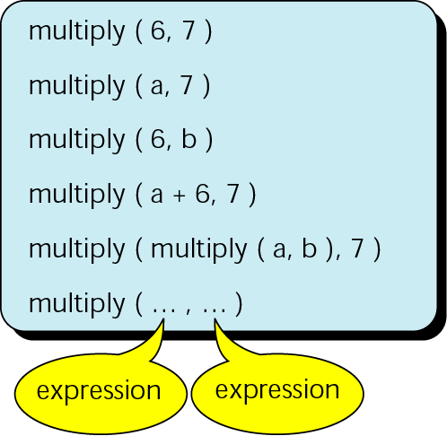
Examples of Function Calls

Slide 19
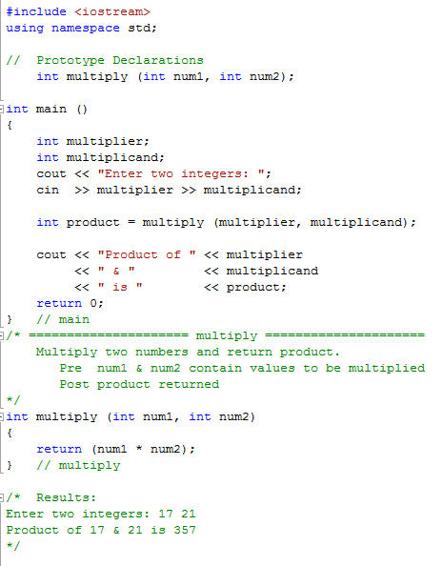
Program 4-1

Slide 20
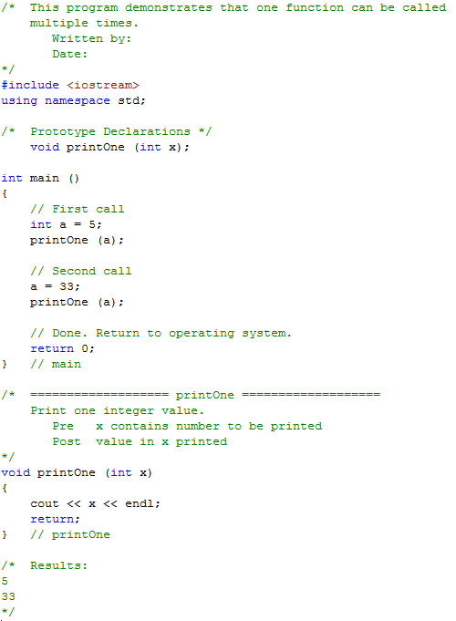
Program 4-2

Slide 21
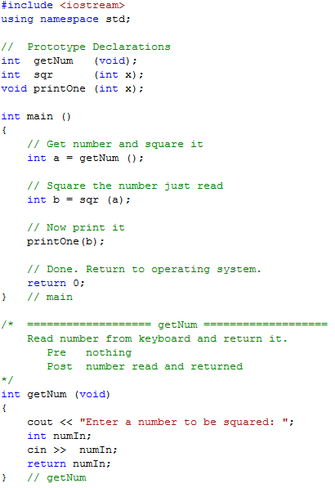
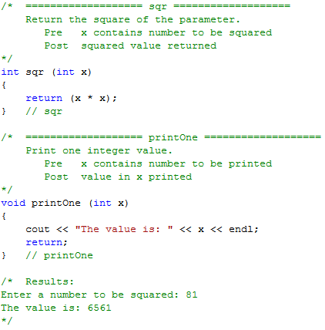
Program 4-3

Slide 22
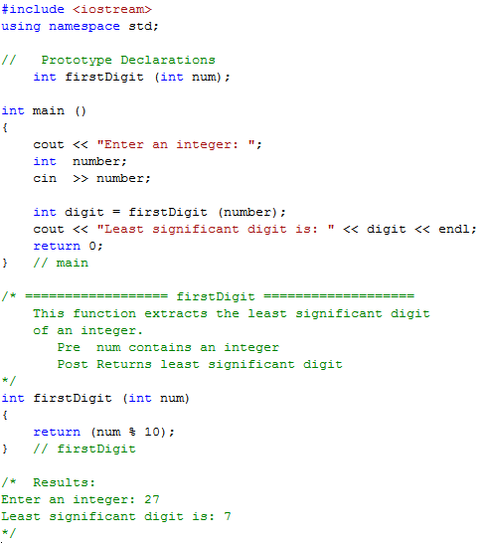
Program 4-4

Slide 23
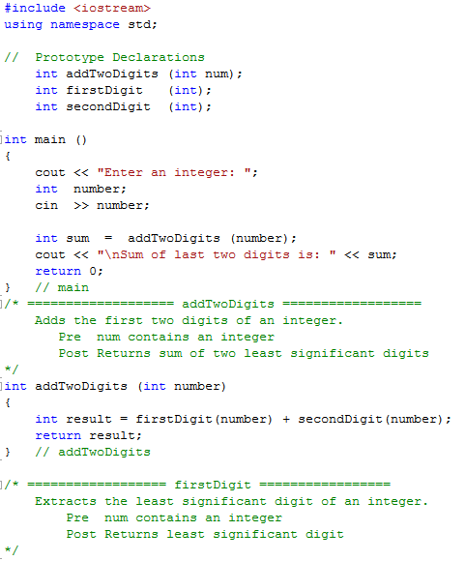
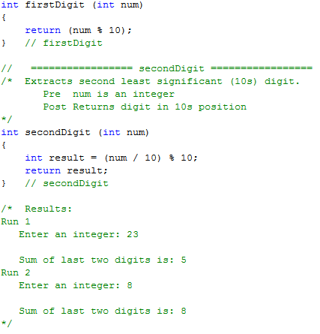
Program 4-5

Slide 24
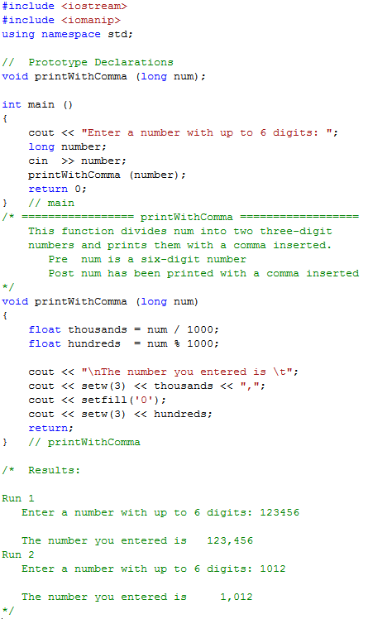
Program 4-6

